Slide 1
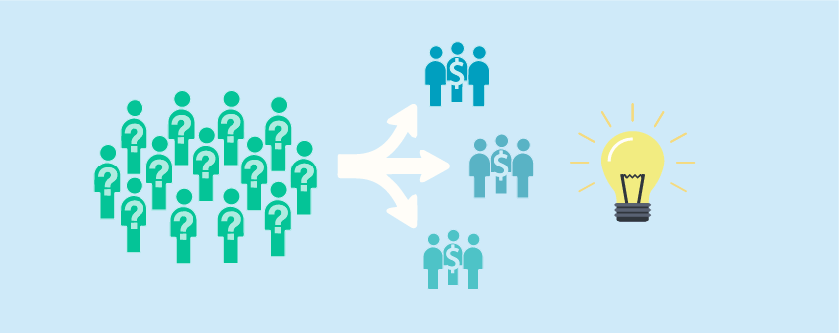
Customer Segmentation for Retail Store
Namrita Gupta
Final Project - 16:137:552:01 PYTHON METHODOLOGIES
Fall 2018

Slide 2
Introduction
To stay in competition retail stores are changing their decision-making approach to be data driven.
Developing the models which are customer centric as this industry business largely depends on its customers.
One such methodology to strengthen the relationship with customer is CUSTOMER SEGMENTATION
In customer segmentation customer base is divided into groups where each group represent the purchase behaviour of the customers linked to that group.
Customer segmentation can be treated as one-size-fit-all approach where a each segment represents a generalised purchase behaviour of all the customers in that segment.
Customer segmentation would help in increase in company’s profit apart from providing selective marketing strategies as per customers segment.

Slide 3
Overall Approach
Data Import
Data Cleaning and aggregation
Exploratory Data Analysis
Data Preparation for modelling
Determine Optimal Number of Clusters
Clustering using K-means algorithm

Slide 4
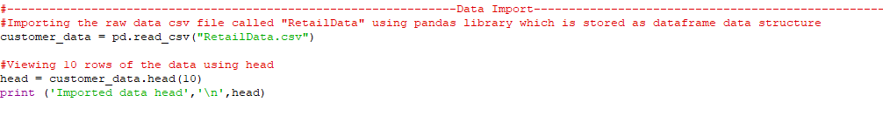
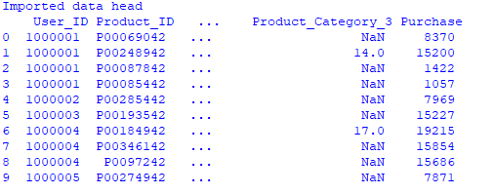
Data Import
The raw data csv file called "RetailData" was imported using pandas library which is stored as data frame structure.
After importing the data,10 rows of the data was viewed using head

Slide 5
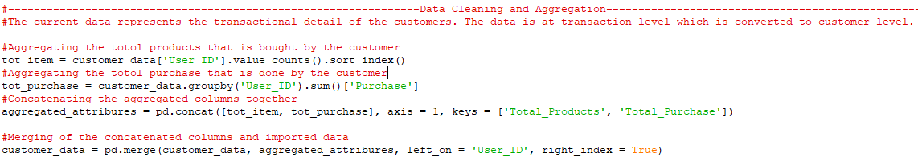
Data Cleaning and Aggregation
The imported data was at transactional level, each row in a data was representing a single transaction done by a customer.
This data was cleaned by removing the missing values and was aggregated to make it at customer level.
Firstly, the two attributes were calculated by “Total_Products” which was number of products bought by the customers and “Total_Purchase” which was the total sales corresponding to each customer.
Then these column were merged to the dataset.

Slide 6
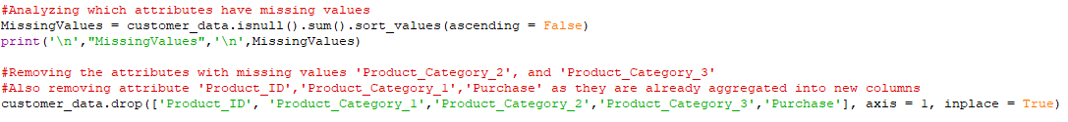
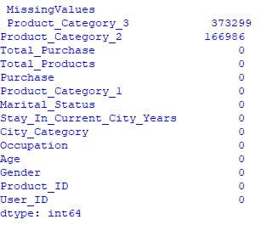
Data Cleaning and Aggregation
Attributes 'Product_Category_2', and 'Product_Category_3’ with missing values were identified and removed from the dataset.
Attribute 'Product_ID','Product_Category_1','Purchase’ were also removed from the dataset as they were already aggregated into new columns

Slide 7
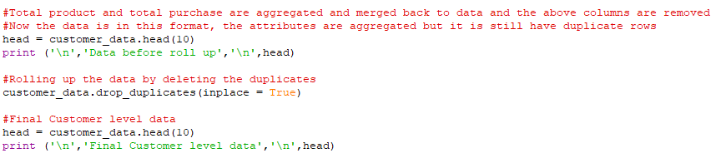
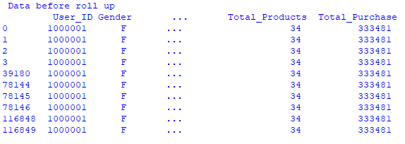
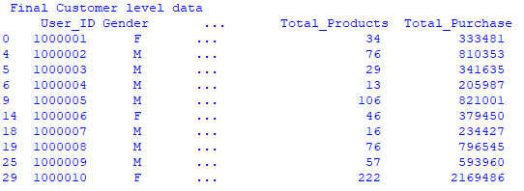
Data Cleaning and Aggregation
Although the attributes were aggregated at customer level but data still had duplicate rows corresponding to the transactions.
To remove these duplicate rows and prepare the customer level data duplicate rows were deleted.

Slide 8
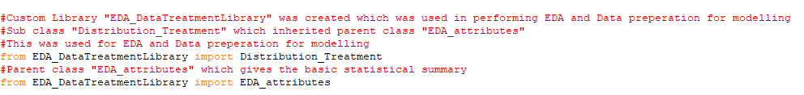
Exploratory data analysis
For performing exploratory data analysis custom library was prepared called “EDA_DataTreatmentLibrary”. This had two classes:
Parent class "EDA_attributes" which gave the basic statistical summary
Sub class "Distribution_Treatment" which inherited parent class "EDA_attributes“. This was used for EDA and Data preparation for modelling.
Class "Distribution_Treatment" have three methods:
distribution_plot and purchase_plot - These method gave the distribution of customers and purchase pattern across different attributes
attribute_treatment - Categorical Attribute that had ordinal values (that can be arranged in order like Age) got Converted from categorical to numerical.

Slide 9
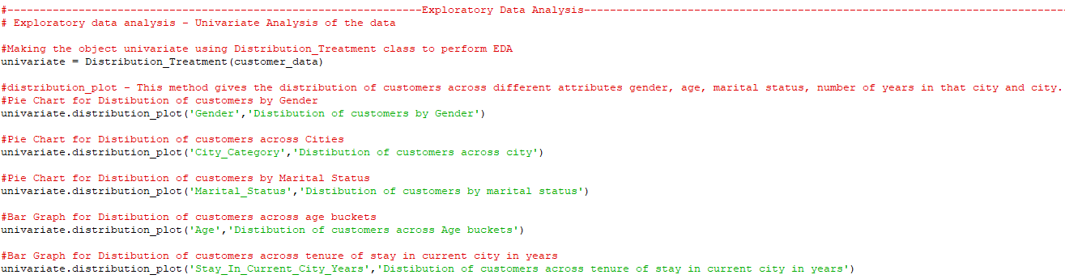
Exploratory data analysis
An object called “univariate” was made for "Distribution_Treatment“ class which used the method “distribution_plot” to the distribution graphs of customers across various attributes for EDA.
This method was called for attributes: gender, age, marital status, number of years in that city and city category.

Slide 10
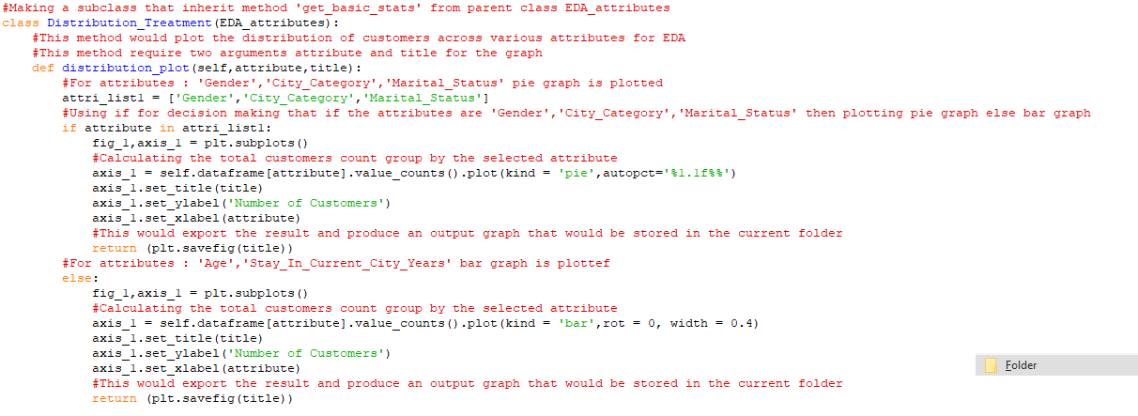
Exploratory data analysis
“distribution_plot” method used “if” conditions to decide whether to plot a pie graph or bar graph based on the attribute.
It plotted pie chart for gender, marital status and city. For stay and age it plotted a bar chart.

Slide 11
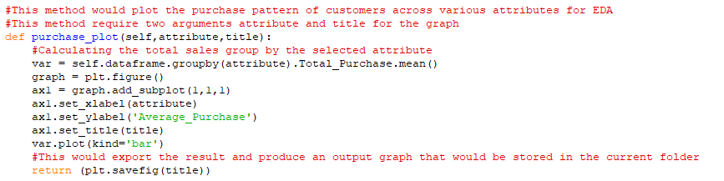
Exploratory data analysis
The object “univariate” was then used for plotting the purchase pattern of customers across various attributes for EDA using the method “purchase_plot” of class “Distribution_Treatment”.
Similarly the method was called for other attributes which included age, marital status, number of years in that city and city.
For these plots mean values of total purchase was used as it gave average result rather than the absolute values.

Slide 12
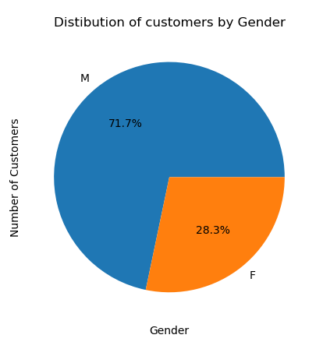
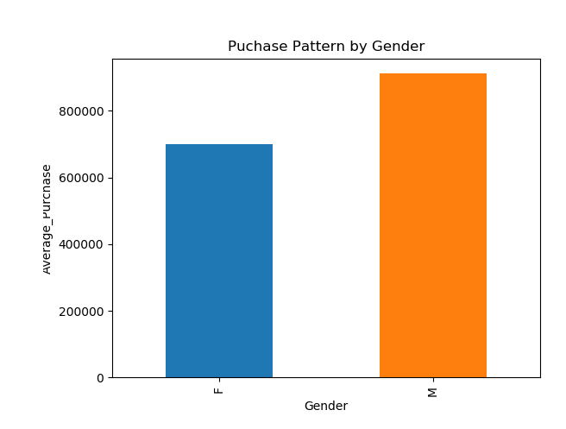
Exploratory data analysis - Gender
EDA on gender attribute revealed that there were more “Male” customers (71.7%) than “Female” customers (28.3%) and “Male” customers are also more likely to purchase than “Female” as they have higher average purchases.

Slide 13
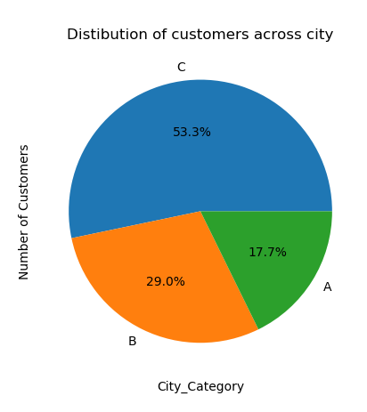
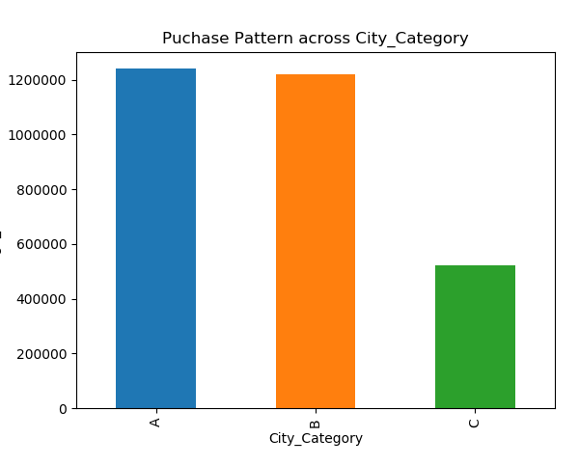
Exploratory data analysis - Cities
EDA on city attribute revealed that although most of the customers (53.3%) were from City C but customers from both the city A and B more likely to buy as they have higher average purchases.

Slide 14
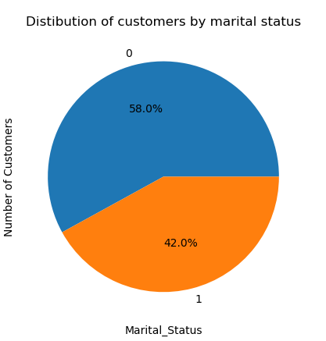
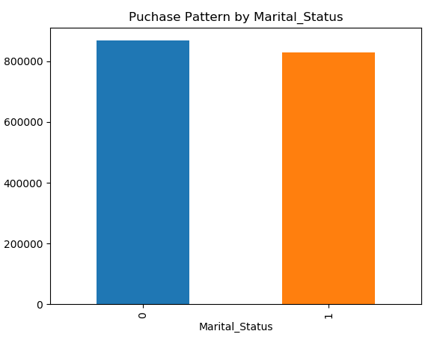
Exploratory data analysis – Marital Status
EDA on marital status attribute revealed that although 58% of the customers were unmarried but there was no clear difference in the purchase pattern between them.

Slide 15
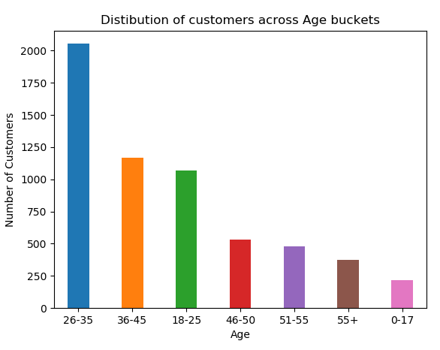
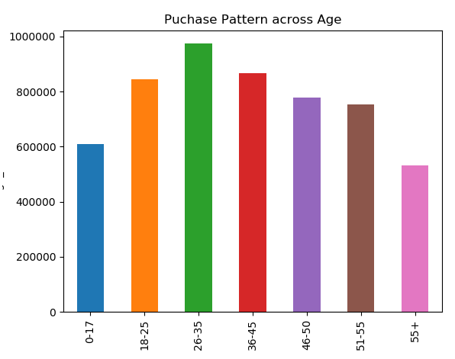
Exploratory data analysis – Age
EDA on age attribute revealed that ~33% of the customers are between the age limit of 26 to 35 and they are more likely to purchase as they have higher average purchases also.

Slide 16
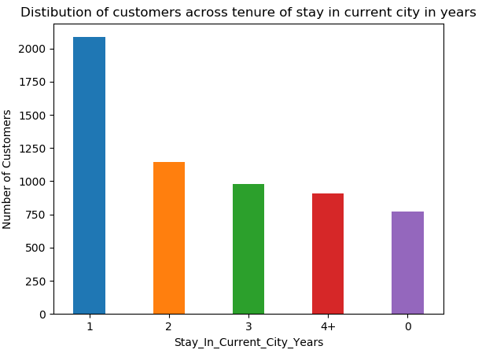
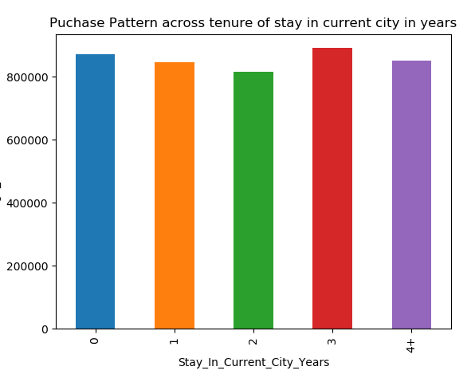
Exploratory data analysis – Tenure of stay
EDA on attribute that refer to the tenure of stay in that location (in year) attribute revealed that ~33% of the customers are staying in that location for an year but there was no clear difference in terms of purchase pattern between them.

Slide 17
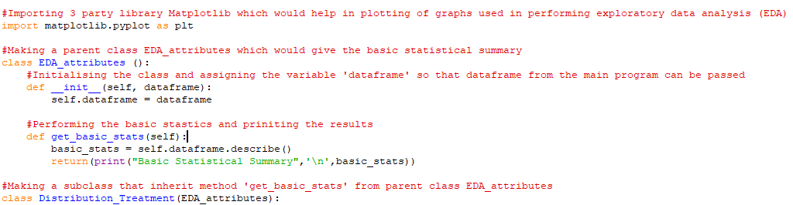
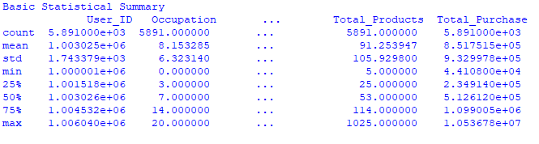
Exploratory data analysis
Basic statistical summary was obtained by using the inheritance property of sub class "Distribution_Treatment" by calling the method of parent class “get_basic_stats()”.

Slide 18
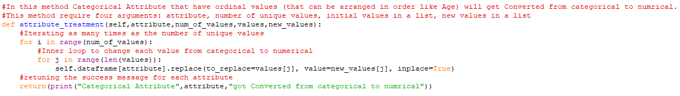
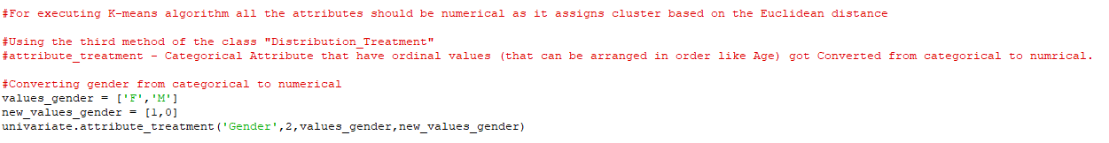
Data Preparation for modelling
The input data for K-means should have all the attributes as numerical as it assigns cluster based on the Euclidean distance.
For converting the ordinal categorical attributes to numerical, “attribute_treatment” method of “Distribution_Treatment” class was used. This method uses iterates over value and convert it accordingly.
Ordinal categorical attributes are the attributes that have ordinal values (that can be arranged in order like Age)
Similarly the method was called for other attributes which included Age and Stay_In_Current_City_Years number of years in that city.

Slide 19
Data Preparation for modelling
Attribute like City_Category didn't had order in the values like the difference between City A and City B is not same as the difference between City A and City C.
City_Category was be converted using rows to column technique. In this, City A, City B and City C would be three column with binary value indicating whether the customer belong to that city or not.
The final prepared dataset was exported as csv file, so that in future it can be directly used for applying other modeling technique.

Slide 20
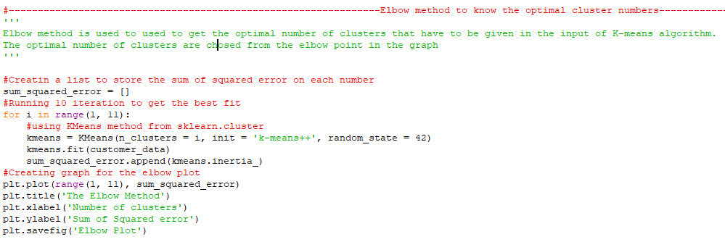
Determine Optimal Number of Clusters
Elbow method is used to used to get the optimal number of clusters that have to be given in the input of K-means algorithm.
The optimal number of clusters are chosen from the elbow point in the graph.

Slide 21
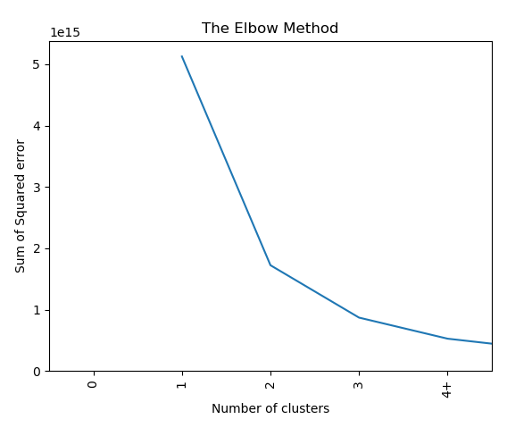
Determine Optimal Number of Clusters
The elbow is formed at 3 in the elbow plot given below. Hence 3 would be given as the number of clusters in input to the K-means algorithm.
Elbow plot is plotted between the number of clusters range and sum of squared errors.

Slide 22
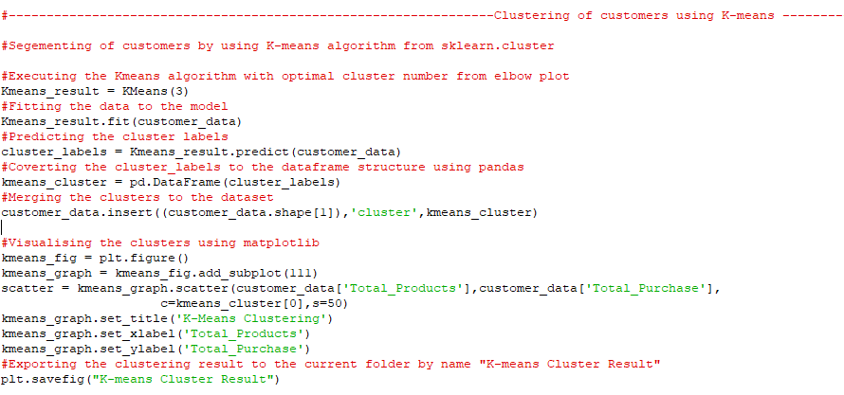
Clustering using K-means algorithm
Segmentation of customers was done using K-means algorithm from sklearn.cluster class.
In this, first the model is formed by giving the optimal number of clusters (which is 3) and then it is fitted to the data and cluster labels are given.
The result of K-means algorithm was analysed using the scatter plot between the “Total_Purchase” and “Total_Products” which were the indicator of customer purchase pattern.

Slide 23
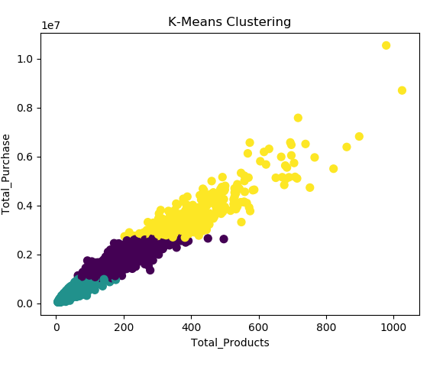
Clustering using K-means algorithm
Three segments represents the customers purchase pattern.
Yellow segment can be called as “High Value Customers” as they have higher purchases as well as they had bought more products when compared to the other two segments.
Green segment can be called as “Low Value Customers” as they have lower purchases as well as they had bought least products when compared to the other two segments.
On the similar lines, purple segment can be called “Medium Value Customers”.

Slide 24
Conclusion
The customer segments formed can be used as a customer base for designing segment specific marketing campaign.
These high value customers can be targeted by giving more rewards point with their every purchase whereas low value customers can be targeted by giving lucrative offers which would lure them for purchasing.
Such strategies would in turn help in increasing the sales of the retail store as well would help in building better relationship with customer as these clusters would be formed based on their purchase behaviours and hence would understand the customer needs.
Customer segmentation can be treated as an intermediate step for designing personalized marketing strategy. Each customer segment would then be analyzed at customer level and based on the his/her spend behavior one-to-one marketing offer would be rolled out.

Slide 25
Appendix

Slide 26
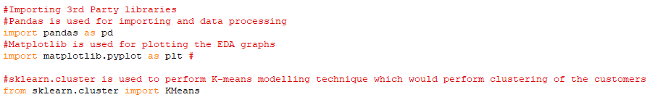
Third Party Library used
Three third party libraries were used:
Pandas was used for importing and data processing
Matplotlib is used for plotting the EDA graphs
sklearn.cluster is used to perform K-means modelling technique which would perform clustering of the customers

Slide 27
Reference
Primary
1.Hong, T., & Kim, E. (2011). Segmenting customers in online stores based on factors that affect the customer’s intention to purchase. Expert Systems With Applications, 39(2), 2127–2131. https://doi.org/10.1016/j.eswa.2011.07.114
2. Sharma, N., Bajpai, A., & Litoriya, M. R. (2012). Comparison the various clustering algorithms of weka tools. facilities, 4(7), 78-80.
Secondary
3. Lockshin, L. S., Spawton, A. L., & Macintosh, G. (1997). Using product, brand and purchasing involvement for retail segmentation. Journal of Retailing and Consumer services, 4(3), 171-183.
4.Katsaras, N., Wolfson, P., Kinsey, J., & Senauer, B. (2001). Data mining: A segmentation analysis of US grocery shoppers. St. Paul, MN: The University of Minnesota, The Retail Food Industry Center, Working Paper, 01-01.
5.Ziafat, H., & Shakeri, M. (2014). Using Data Mining Techniques in Customer Segmentation. Journal of Engineering Research and Applications, 4(9), 70-79.

